Slide 2
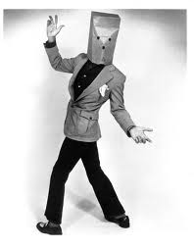
About The Presenter
Chief Bloviater
30 Years in Consumer Product Marketing
Promotion Agency Owner
Numerous awards for best strategy, creative and tactics. Engineered many package centered promotions including Patent #5,571,358
Partner – Napier Marketing Group, Inc.
More information on LinkedIn
12 years in the Home Furnishing’s Industry
CMO Ashley Furniture, LeatherTrend, Home Line Furniture & Napier Marketing Group.
Winner Gold Reggie - Best Promotion in North America from the Promotional Marketing Association while at Ashley Furniture – implemented the 2 largest promotions ever in the HF Industry.
Published many articles in NHFA Retailer, HFB and more
Bill Napier
billnapier@napiermkt.com
bill@social4retail.com
612-217-1297
www.napiermkt.com
www.social4retail.com

Slide 4
HOPE Noun: [Hohp]
The opposite of which is despair
The feeling that what is wanted can be
had or that events will turn out for the best:

Slide 5
Why is it
Why is it a man wakes up in the morning, after sleeping on his advertised bed, on his advertised mattress in his advertised pajamas. He will bathe in his advertised tub, shave with his advertised razor and shaving cream, have breakfast with his advertised juice, cereal and toast….toasted in his advertised toaster, put on advertised branded clothes and quickly glance at his advertised watch. He will catch the news on his new advertised flat screen that he purchased at a heavily advertised store. He will ride to work in his advertised car, sit at his advertised desk and write with his advertised pen or utilize his advertised computer.

Slide 6
Yet it’s ironic that when he’s approached to advertise his business, he says advertising doesn’t pay…..until his business fails;
Then he’ll gladly advertise the sale and liquidation of his business……why; so people will come and liquidate his assets.
Why is it

Slide 7
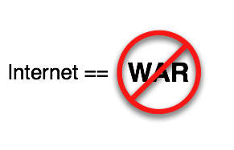

Slide 8
It’s Time to STOP interrupting what people are interested in
and
become what people are interested.

Slide 9
The internet has fundamentally changed the way people find, discover, share, shop and connect

Slide 10
Out With The Old
In With The New

Slide 11
More than ¾ of adults are on-line
164,000,000 consumers are looking to “connect”
94% send and review email
87% use search engines
78% do product research
61% are “Social Networking
32% rate products

Slide 12
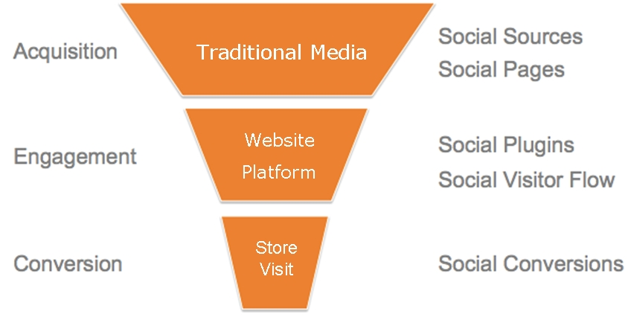

Slide 13
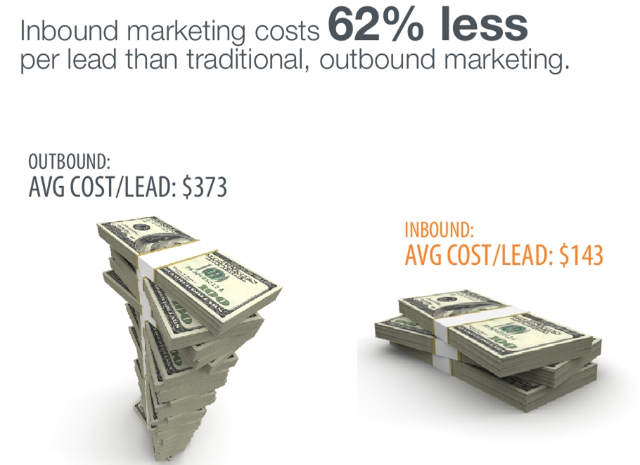

Slide 14
How do YOU get your fair share?

Slide 15
GET SOCIAL
FACT:
It’s NOT a fad
It’s a revolution

Slide 16
Be everywhere
When consumers WANT to find you
Where they WANT to find you
How they WANT to find you

Slide 17
The 10 platforms we believe are relevant for retail

Slide 18
#1

Slide 21
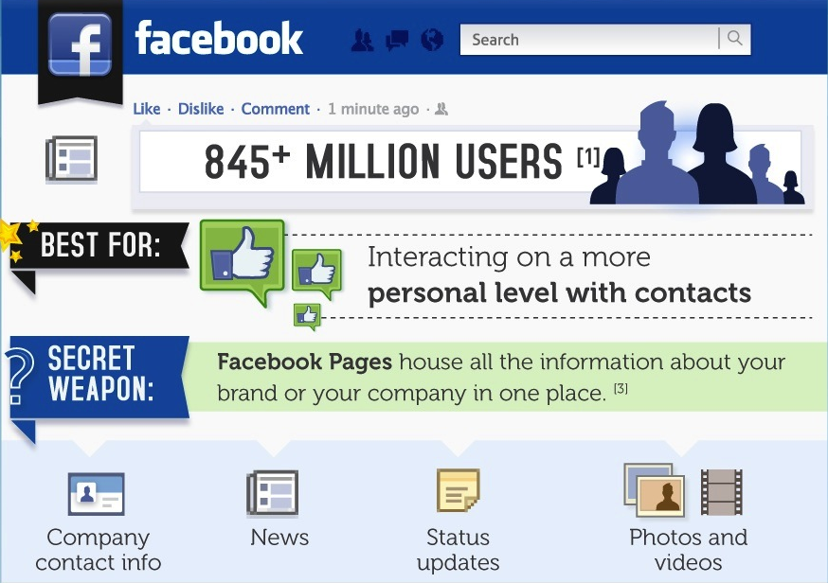

Slide 23
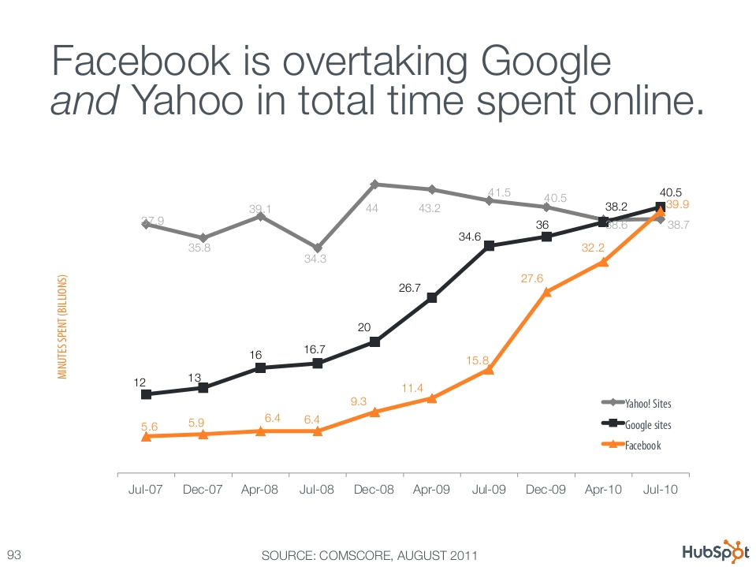

Slide 24
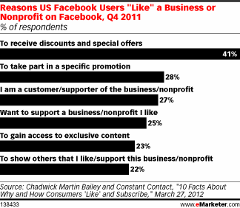

Slide 25
Ideas & Concepts
Photo/Video Contests - each new like could/must post a photo that people can vote on (note: encouraging photo entries to promote their photo to their own list of friends will get you even more likes!) Ref: Ugly room/sofa/home makeover. HUMOR is always the best- Ref: The Red House – Also, have them vote on new intro’s from market – Jake Jabs does this
Random Prize Drawings Pulled From all Facebook Likes - ask them to post on your wall to be considered for the contest... this encourages - page activity that their friends will also see and hopefully join in.
Special Discount Offers To all Facebook Likes - use your page as a communication tool for distributing "Facebook only" promotions, discounts or coupons to keep customers coming back to your page…BUT remember to drive them to your website to “Sign Up” for specials & Offers for your business
Small Prize to First X# of Facebook Likes - award everyone something for quickly liking your page (coupons work well for this)
Charitable Donations - giveaways to a charity appeal to people's desire to support a cause - increase your donation level if you reach certain quotas with total likes

Slide 26
Ideas & Concepts
Have a plan and a strategy – (Study what others are doing well)
Think about what you want out of your Facebook presence. Is it more foot traffic? More sales? Or is it just more contact info to populate your newsletter mailing list? Figuring out your goals is the first step in initiating and directing your Facebook presence.
Link all Social Media to Facebook Business Page
Keep Facebook Content Fresh for Ongoing Promotions
Post a today-only 25% off coupon for your fans to print and bring in
Emphasize Interaction Posts to your wall from your customers become instantaneous feedback that you can use to make appropriate changes, resolve issues and even enjoy compliments. And because you’re the owner, you make the decisions.
Be available - !!!! - Review your post 3X/day – Early AM, Noon, and 6PM
Take action - Answer everything ASAP, especially complaints
Be flexible – It’s a moving target
Let your fans know via wall post that everyone who comes in and mentions the post gets something

Slide 27
DO NOT POST “STUFF” That’s IRRELEVANT
Like American Express Did To Me
DO NOT post basic stuff just to post
For Instance
A sofa is a great place to take a nap
The weather
I’m Happy
I’m Sad
Stuff that will make “ME” hide you and unsubscribe

Slide 28
#2

Slide 29
Pinterest Drives More Traffic Than Google+, YouTube & LinkedIn
10,000,000+ active users 97% are women. HOME is the #1 Pinned element!

Slide 30
What is
Pinterest lets you organize and share all the beautiful things you find on the web. People use pinboards to plan their weddings, decorate their homes, and organize their favorite recipes. Best of all, you can browse pinboards created by other people. Browsing pinboards is a fun way to discover new things and get inspiration from people who share your interests.

Slide 31
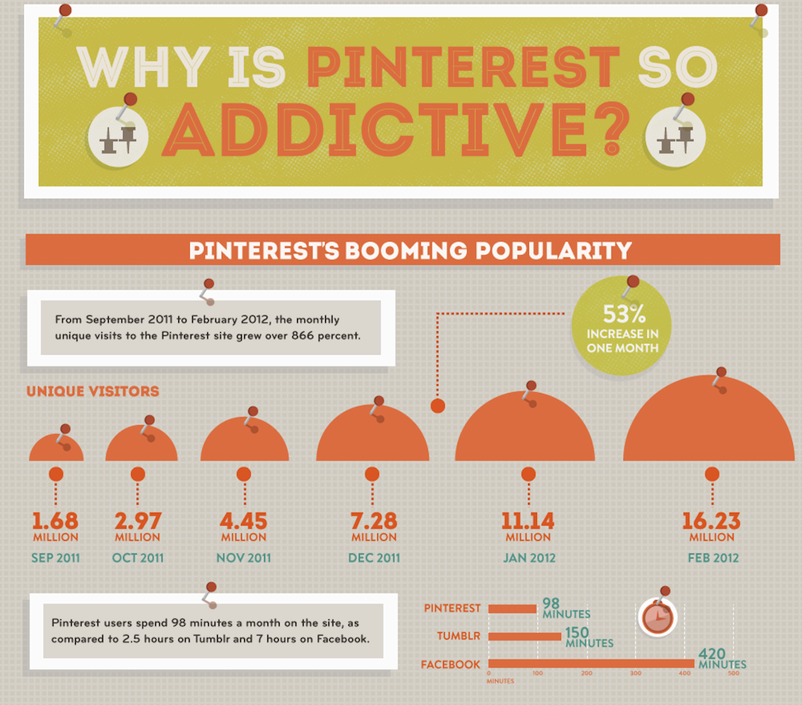

Slide 32
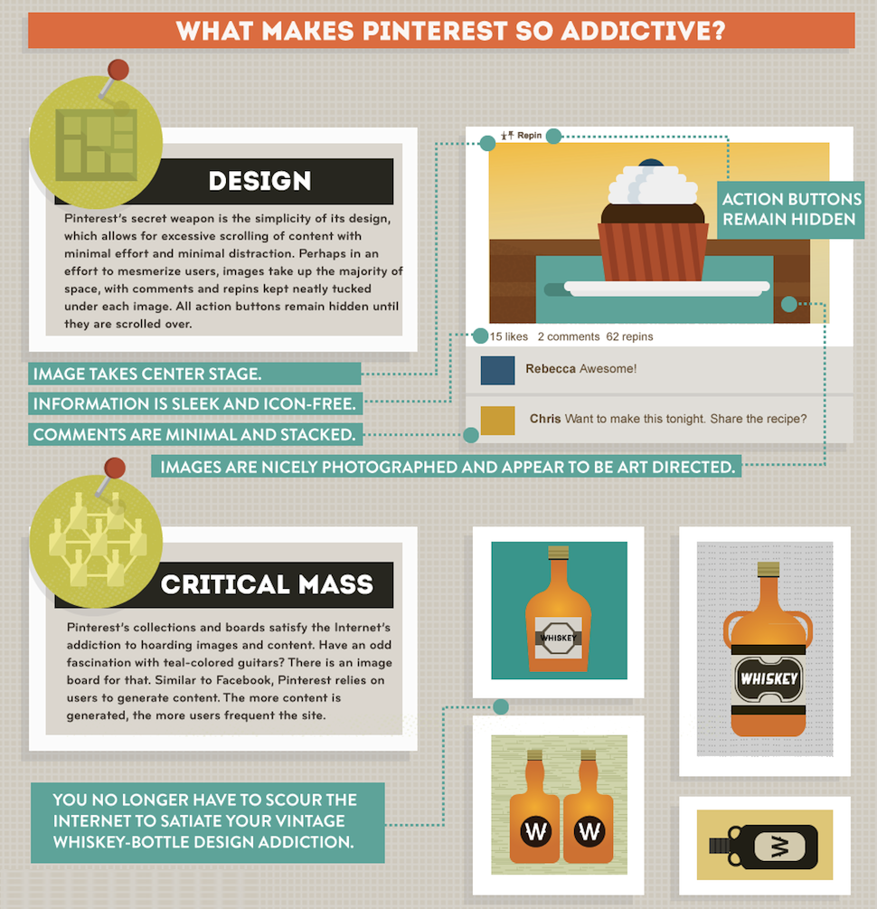

Slide 33
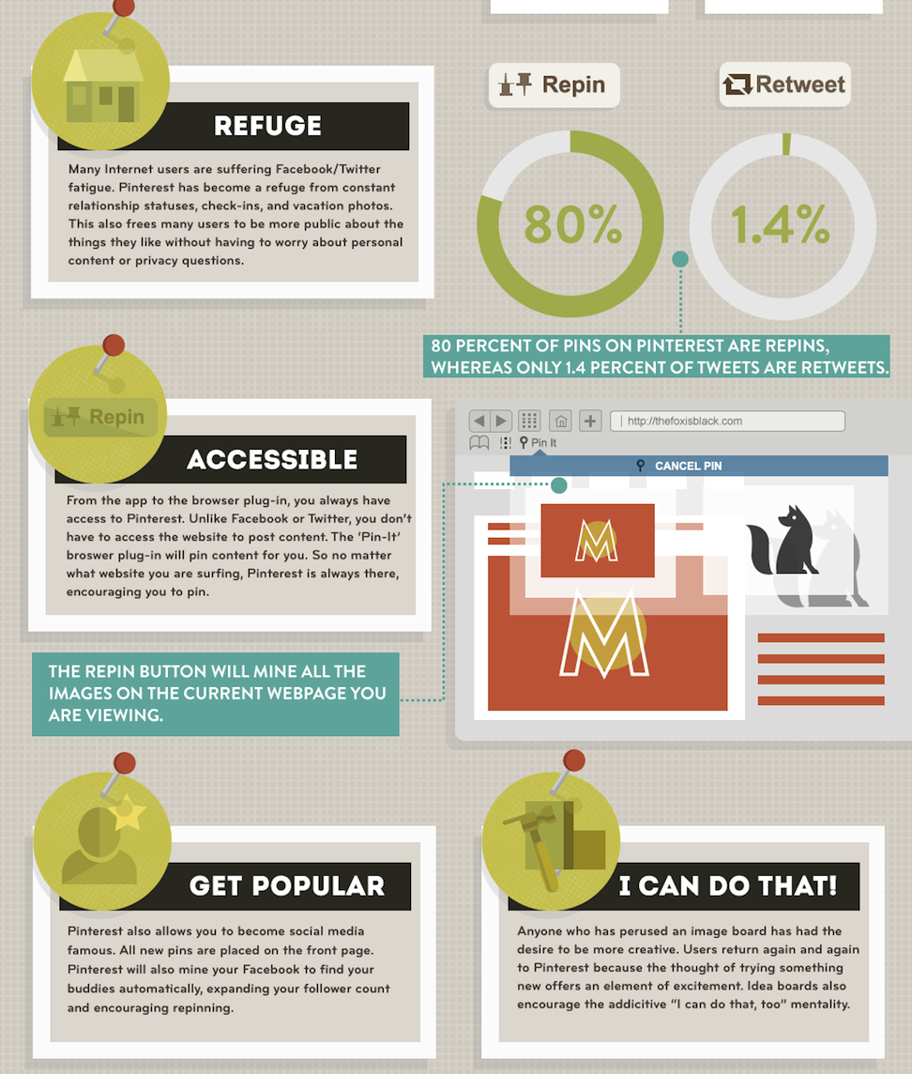
Share/express what you like - visually - without personal intrusion
Easy access with “PIN” in browser. Point & Click where you are on the internet and it’s “PINED”
Integrated with your social platforms to “share”

Slide 34
#3

Slide 36
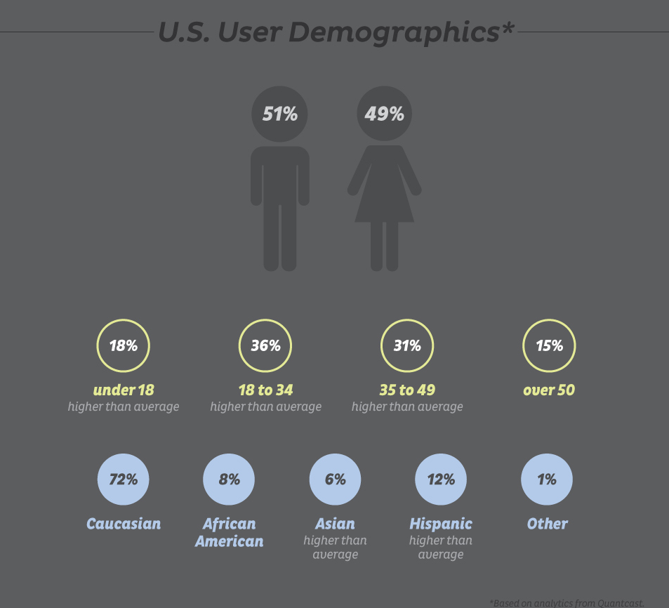

Slide 38
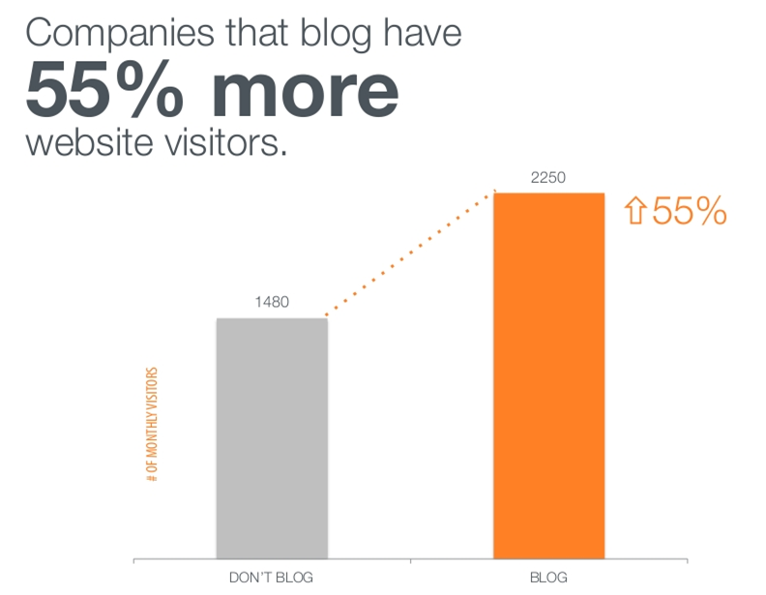

Slide 39
#4

Slide 40
250,000,000 tweets per day – 55% women sharing what their thoughts, likes and experiences are with their followers

Slide 42
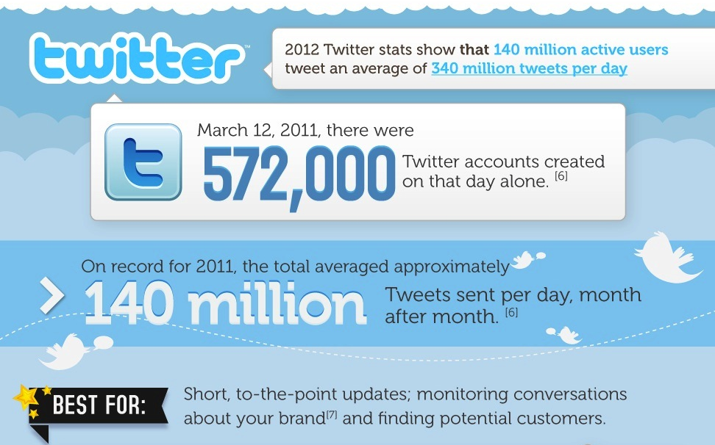

Slide 43
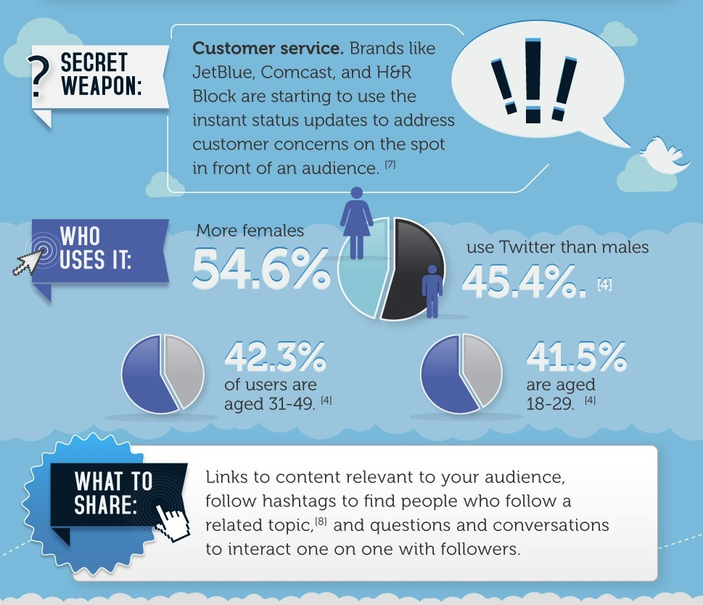

Slide 44
#5

Slide 45
18,000,000+ members
Yep, it's a web aggregation and this is perfect for home furnishing retailers

Slide 46
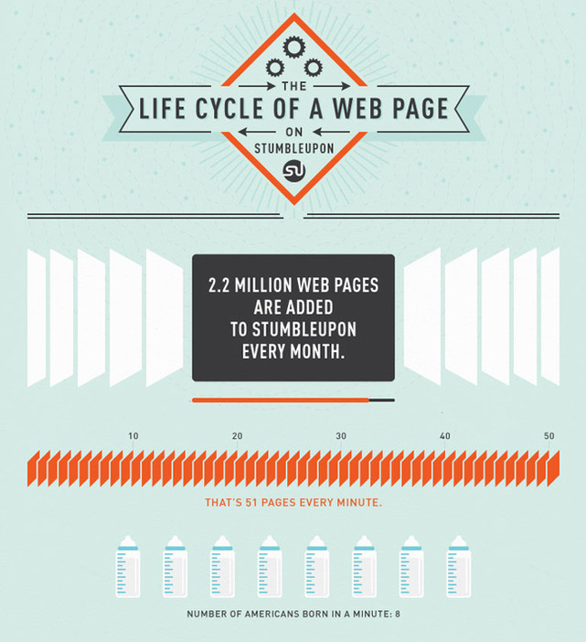

Slide 47
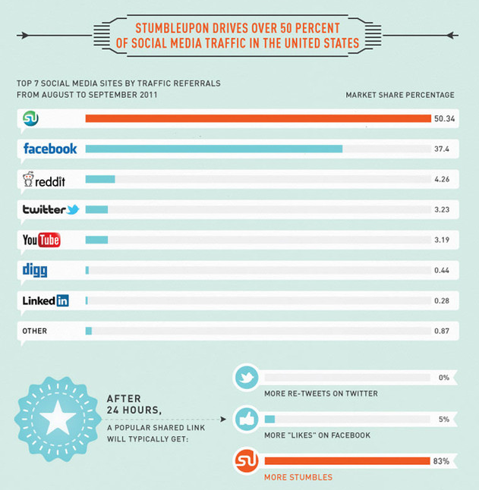

Slide 48
#6

Slide 49
53 million people visited Yelp in the past 30 days

Slide 50
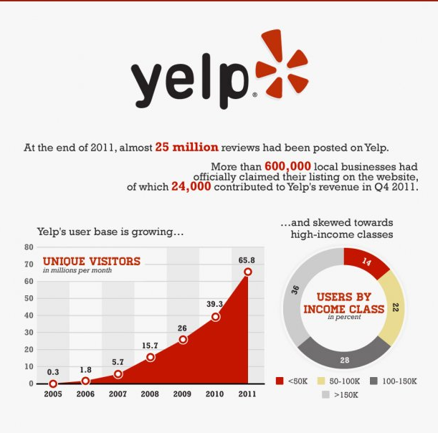
86% have income above
$50,000.00

Slide 51
Join Yelp & Write Reviews (yelp.com)
Put your Business Profile on Yelp (biz.yelp.com)
Post Discounts and Announcements
Ask for Reviews from your Clients
Build a Network on Yelp – Like other social networks – friend/review/recommend
Create Events on Yelp (yelp.com/events)
Use the updated iPhone/Android/Smartphone Apps to Check-In
Link Your Yelps with your Twitter and Facebook Profiles

Slide 52
#7

Slide 54
It’s
DUH !!!

Slide 55
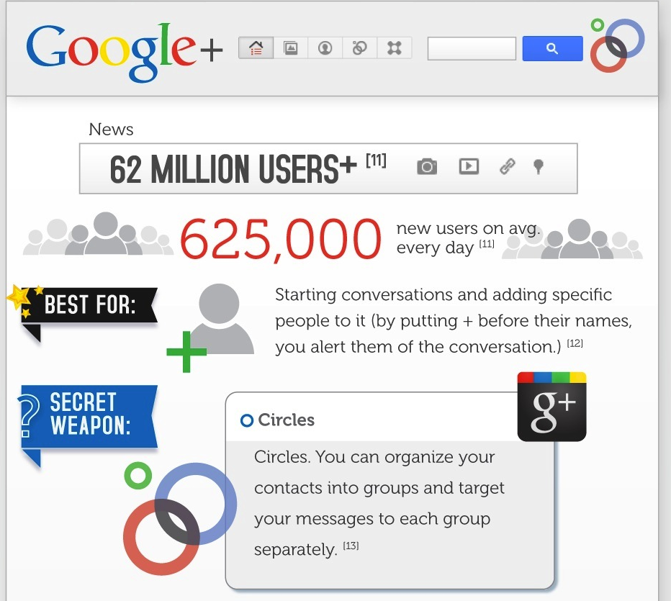

Slide 57
Circles – You can segment your circles/audience
Photos - photos in Google + will rank VERY highly in Google Image search
Hangouts - It’s basically a way of hanging out with loads of people at the same time using video chat. Great for new intro’s

Slide 58
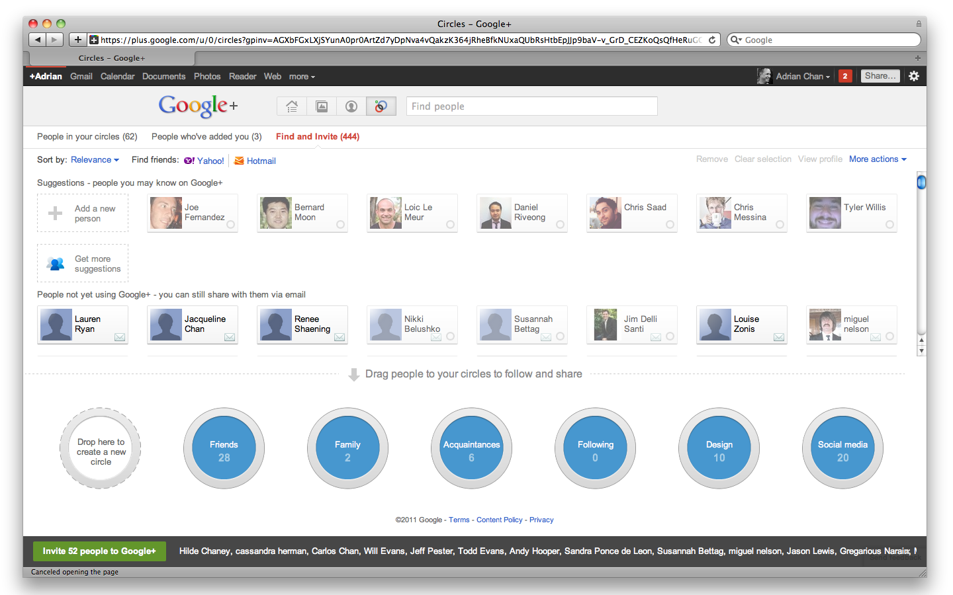

Slide 59
Instant Photo Upload from Mobile – Clearance, specials, etc.
Sparks - personalized content feed into your stream, you tell “Sparks” what you are “in to” and they will send you stuff (videos, content etc.) that’s relevant to you.
Huddle - “group chat”, allows you to chat with several people at once

Slide 60
#8

Slide 61
More Than 1,000,000,000,000 Playbacks
(One Trillion) (Yep, Count ‘Em, 12 Zeroes).
And…It’s owned by:

Slide 62
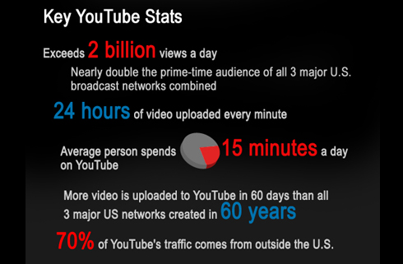

Slide 63
Create a Branded YouTube Channel
Your Store – Tour, New Intro’s, etc
Make Sure Your Content Fills a Relevant Need
Develop Videos that are Quick, Simple, Engaging, and Professional
Reference Sheely’s Furniture: http://www.sheelys.com/
RTA Videos –
Mattress (Different types and why)
Leather – types and why they are good for: Bonded – Top Grain, Bi-cast, etc.
Optimize Your Video – SEO
Integrate YouTube videos into your site and share everywhere

Slide 64
Humor Seems To Work Best
Go to YouTube & Search For: The Red House (2.5MM Views)

Slide 65
#9

Slide 66
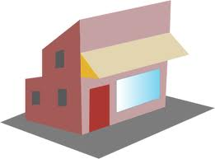
Location Based Marketing
More Ways To get Them Into Your Store

Slide 67
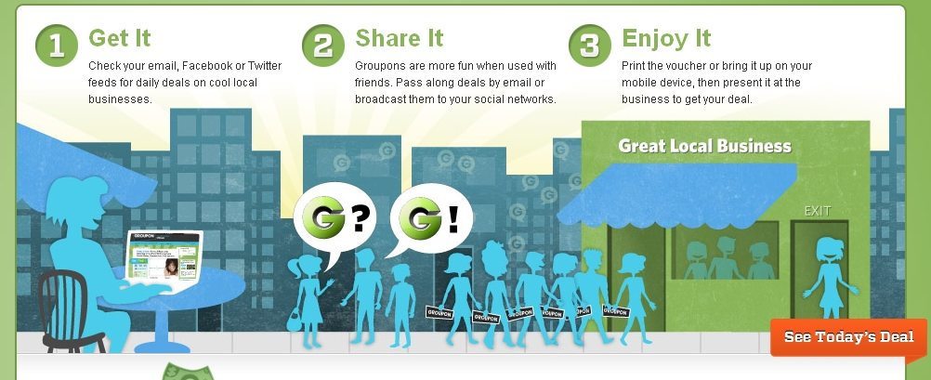

Slide 69
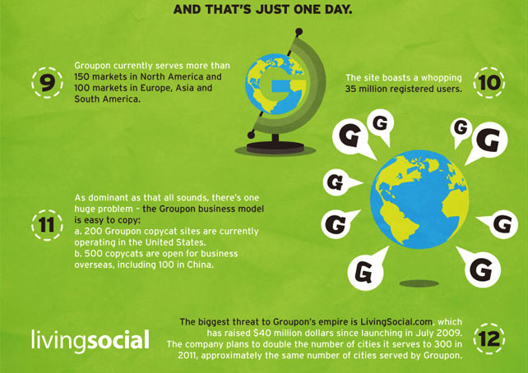

Slide 70
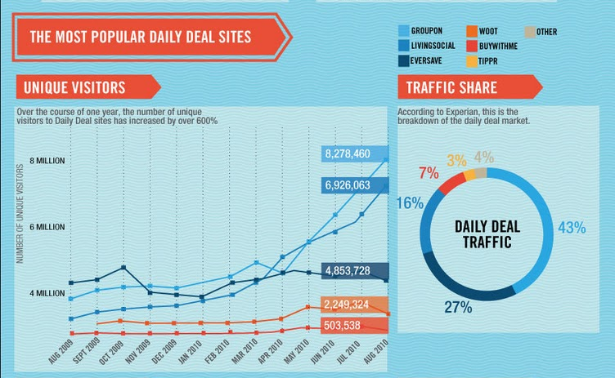

Slide 71
#10

Slide 72
Location Based Marketing
Now that you’ve got them to your store…..
Now what?

Slide 73
18,000,000 – 30,000,000
Discover what’s nearby, save money and unlock deals.

Slide 74
BUT….

Slide 75
Without a great WEBSITE

Slide 76
Your in-bound strategy will
FAIL!

Slide 77
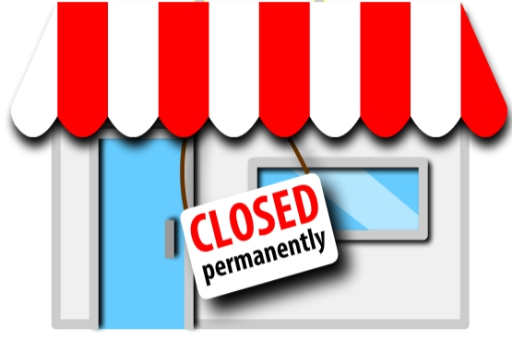

Slide 78
“Things May Come To Those Who Wait….
But Only Those Things Left By Those That Hustle”
Abraham Lincoln

Slide 79
“You Can’t Think Yourself Into Acting
You Must Act Yourself Into Thinking”
Napierism

Slide 80
So If You Don’t Do Social….
What’s Your ROI On That?

Slide 81
Thank You
Get This Presentation & More:
My LinkedIn Profile: http://www.linkedin.com/in/wfnapier
Email me:
bill@social4retail.com
On Our Site: http://www.social4retail.com/how-to-do-social-integration.html

